Slide 1

World Economic Classification

Slide 2

Content:
Introduction
About Data and Source
Data Preparation
How Many Countries belong to the UN ,EU and export fuel?
What is the Wealth rank for countries based on GDP at ppp, and which of them export fuel?
Which countries are member in EU and what are their rank?
What is the Classification according UN/DESA 2014 and IMF2023 for each country?
Distribution of countries based on their fuel export and AVG_GDP
the Relation between AVG_GDP and GDP Ratio indicators
How does GDP per capita at PPP compare to GDP per capita for each country in 2022?
How does GDP per capita at ppp compare to GDP per capita for each country in 2022?
Map Visual show Countries Classification based on UN class2014 and GDP at ppp
Conclusion

Slide 3

Introduction:
Experts debate exactly how to define the level of economic development of a country—which criteria to use and, therefore, which countries are truly developed. This debate crosses political, economic, and social arguments.
When evaluating a country, a manager is assessing the country’s income and the purchasing power of its people; the legal, regulatory, and commercial infrastructure, including communication, transportation, and energy; and the overall sophistication of the business environment

Slide 4
About Data and Source:
Sources
https://www.kaggle.com/datasets/jeanetteponder/world-economic-classifications/data
Development Policy and Analysis Division (DPAD) of the Department of Economic and Social Affairs of the United Nations Secretariat (UN/DESA), "Country Classification," 2014.
International Monetary Fund, "World Economic Outlook Database: Groups and Aggregates Information," April 2023
About Data:
Economic Classification Dataset based on Classifications from the Development Policy and Analysis Division It describes basic economic conditions and is based on World Economic Situation and Prospects (WESP) data
and Classifications from the International Monetary Fund (IMF)'s April 2023 report, "World Economic Outlook Database: Groups and Aggregates Information

Slide 5
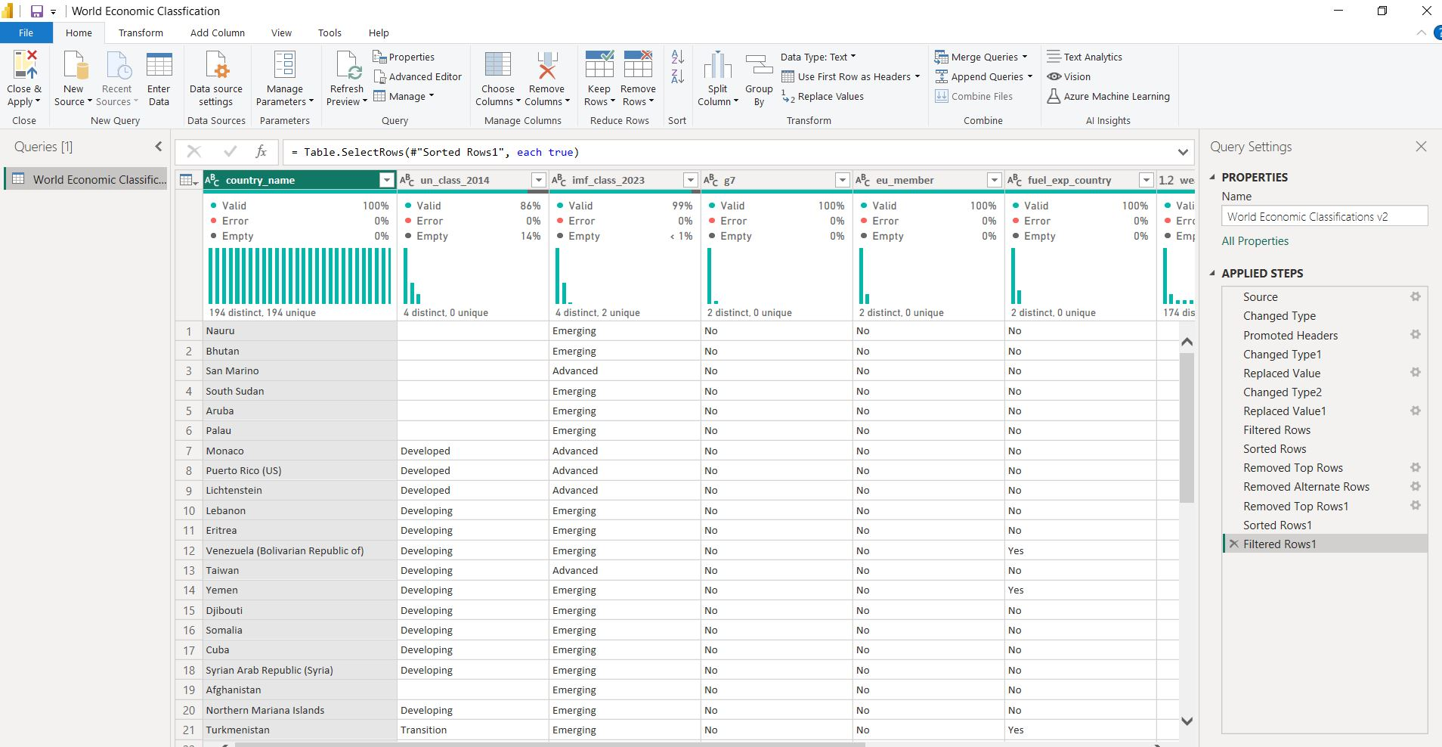
Data preparation and Cleaning

Slide 6

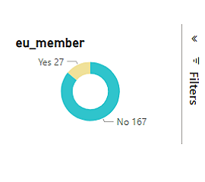
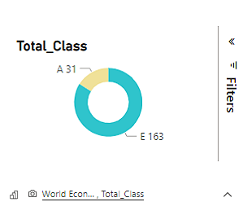
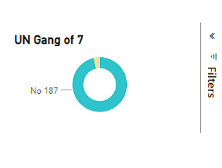
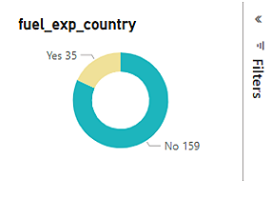
How Many Countries belong to the UN ,EU and export fuel?
This Visual show nom of countries in UN, EU and export fuel and who are the most

Slide 7

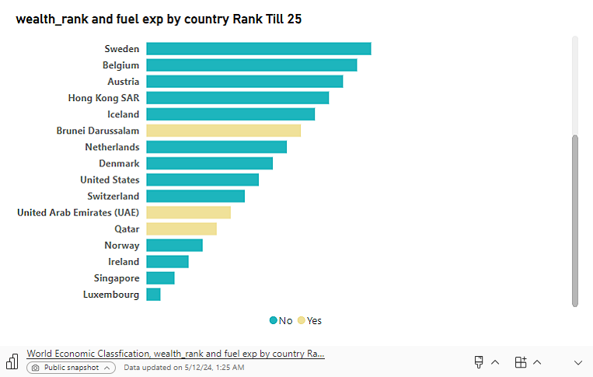
the Wealth rank for countries based on GDP at ppp, and which of them export fuel
As we can see that is Luxembourg the highest country ranked economical but it doesn't as fuel export country and in another hand there are Qatar ranked as 5 economical and fuel export country

Slide 8
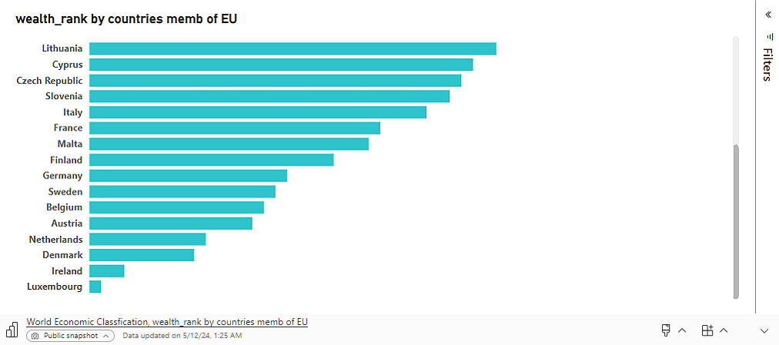
countries are member in EU and what are their rank from 1 till 25 as Luxembourg is the highest country ranked economical

Slide 9
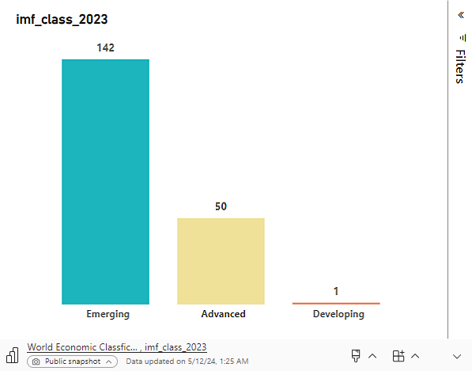
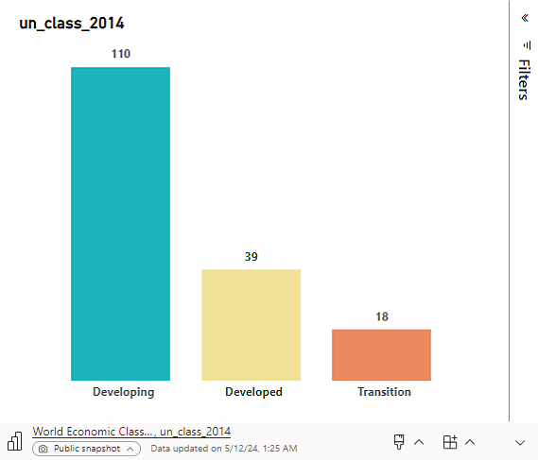
What is the Classification according UN/DESA 2014 and IMF2023 for each country?

Slide 10
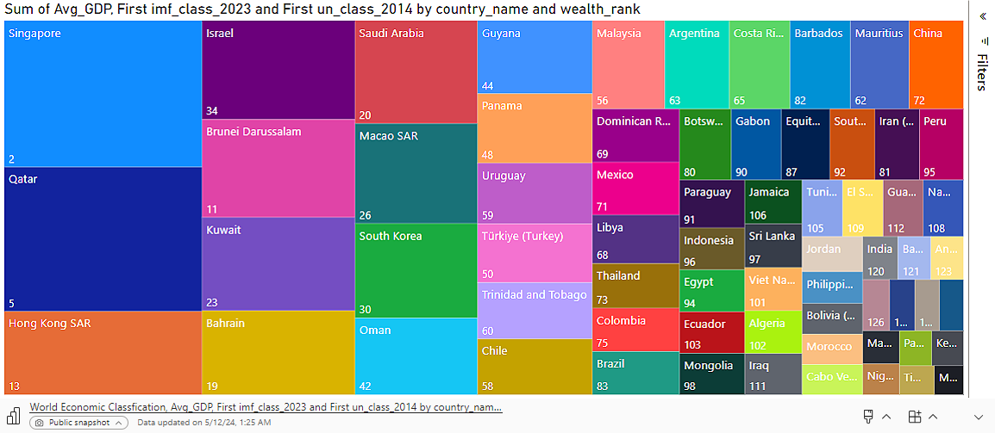
And this visual is a drill throw to show who is the countries in each categories

Slide 11
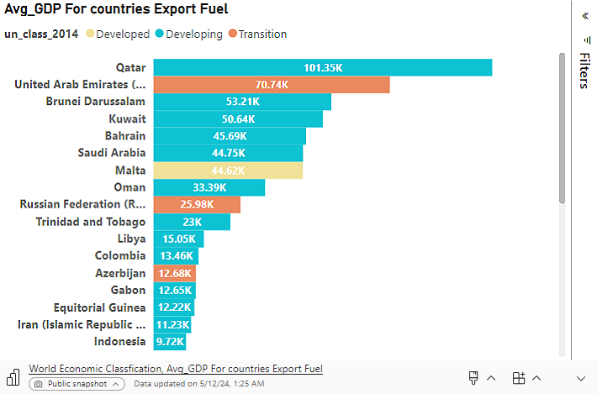
Distribution of countries based on their fuel export and AVG_GDP
This visual show Avg GDP for fuel export countries This can help you visualize the proportion of fuel-exporting countries in different GDP ranges.

Slide 12
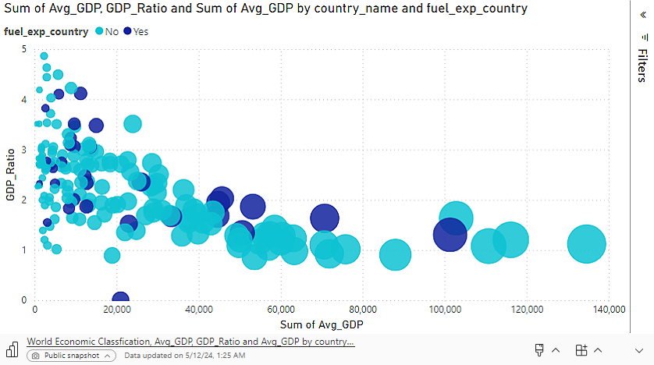
the Relation between AVG_GDP and GDP Ratio indicators
This indicates that most countries have a GDP_Ratio value below the average. This clustering could be evidence of an unbalanced distribution of wealth, with many countries having below average GDP in terms of purchasing power. This type of trend can reflect economic gaps between countries, as some countries suffer from weak or deteriorating economies, leading to a decline in the value of their GDP in terms of their purchasing power. On the other hand, there may be other countries with economic strength that make their average GDP with purchasing power less than the global average.

Slide 13
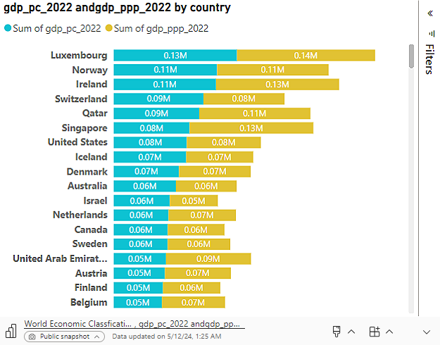
How does GDP per capita at ppp compare to GDP per capita for each country in 2022?
Per capita GDP is a measure of the total economic wealth of countries, usually calculated by dividing the country's GDP by its population. This measure is used to estimate the level of wealth and productivity for each individual in the country.
On the other hand, Per capita GDP at PPP is considered a more accurate measure of the actual wealth level of an individual in the country, taking into account the cost of living in each country. It corrects for differences in prices of goods and services between countries using the concept of PPP, allowing for a more accurate comparison of wealth levels across different countries.

Slide 14
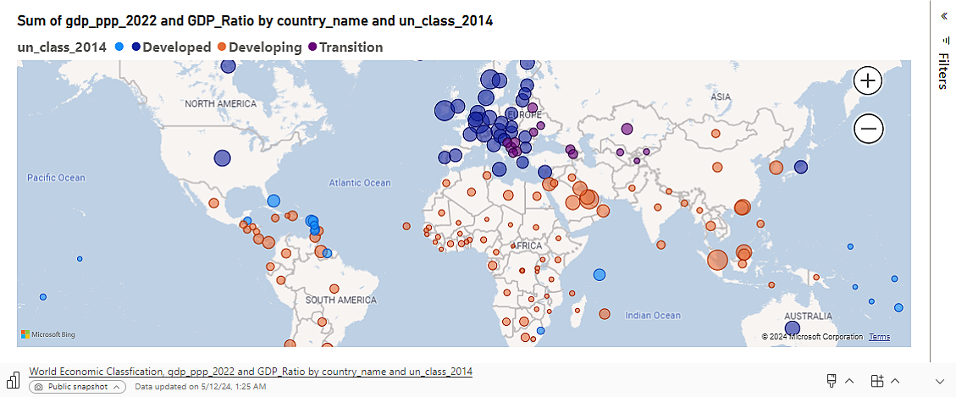
Map Visual show Countries Classification based on UN class2014 and GDP at ppp

Slide 15

Conclusion :
There are some classifications that are commonly used to define a stage of a country’s development. The GDP is the value of all the goods and services produced by a country in a single year. The income per person, a better indicator of the strength of the local economy and the market opportunity for a new consumer product
to compare production and income across countries, economists adjust this number to reflect the different costs of living in specific countries. PPP adjusts the exchange rate between countries to ensure that a good is purchased for the same price in the same currency.

